Slide 1

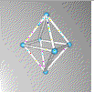

PhyCloak: Obfuscating Sensing from Communication Signals
Yue Qiao, Ouyang Zhang, Wenjie Zhou, Kannan Srinivasan and Anish Arora
Department of Computer Science and Engineering

Slide 2







RF Based Sensing
Reflection plane
Multipath propagation
Tx
Rx
Channel distortion
Target
RF based sensing
Tx
Sensor

Slide 3

A New Threat
Target
Traditional RF sensing
Tx
Sensor
Comm-based RF sensing
Data Tx
Data Rx
Target
sensor

Slide 4
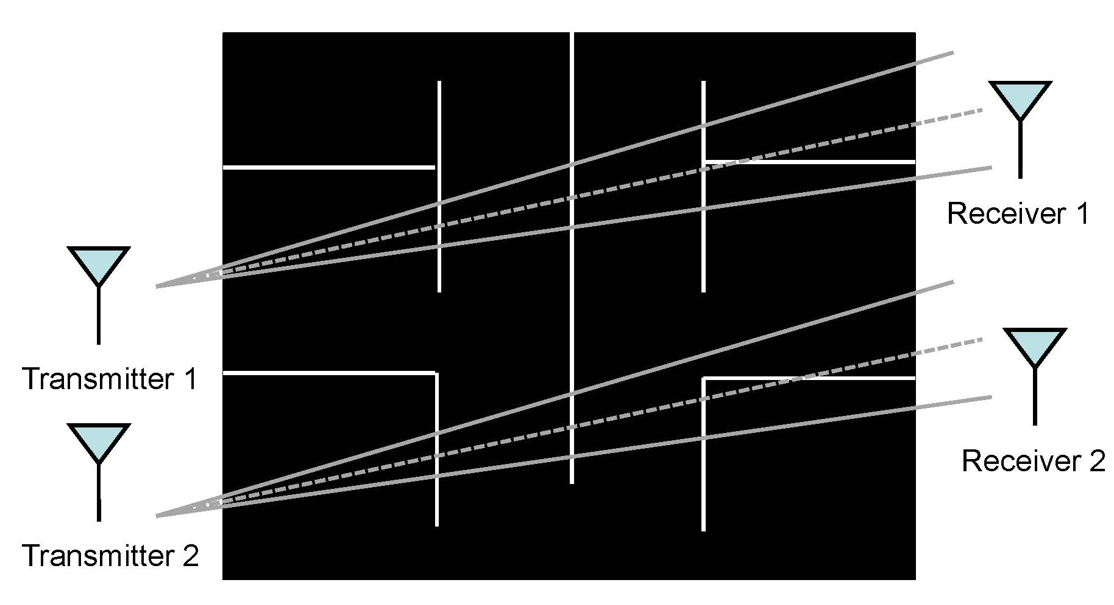
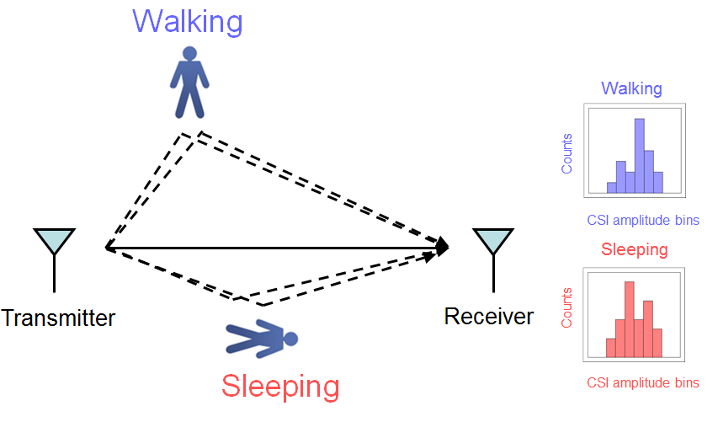
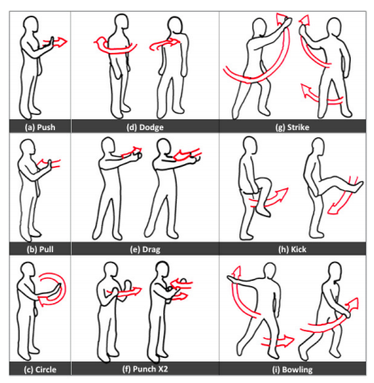
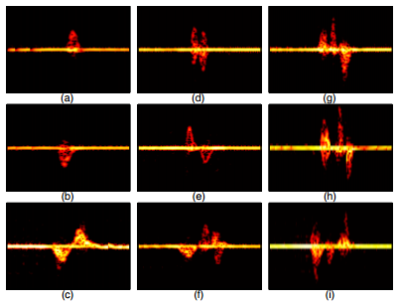

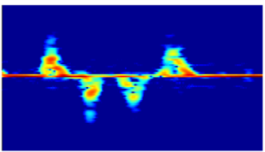
Comm-based Sensing: Examples
Direction
θ
Rich signature, rich fine-grained information
Privacy is leaked from communication signals!
θ
θ
Time (seconds)
Antenna array
One antenna
Wang, et al. E-eyes: device-free location-oriented activity identification
using fine-grained wifi signatures, Mobicom'14
Adib et al., See through walls with wifi!, Sigcomm'13
Pu et al., whole home gesture recognition using wireless signals, Mobicom'13
Gonzalez-Ruiz et al., an integrated framework for obstacle mapping with see-through capabilities using laser and wireless channel measurements, Sensors Journal, IEEE, 2014.

Slide 5






Problem Statement
data
communication
Alice
Bob
Illegitimate
sensing
Jammer
Obfuscator
Target
Eve
A stand-alone black-box obfuscator:
Obfuscate all illegitimate single-antenna sensors
  No knowledge of the sensing technique
Not degrade any wireless data receivers
  No knowledge of the data transmission protocol
Obfuscate illegitimate sensing

Slide 6
Requirements
1. Obfuscate all sensors without knowing their techniques?
2. Do not degrade data links no matter what transmission protocols are being used?

Slide 7


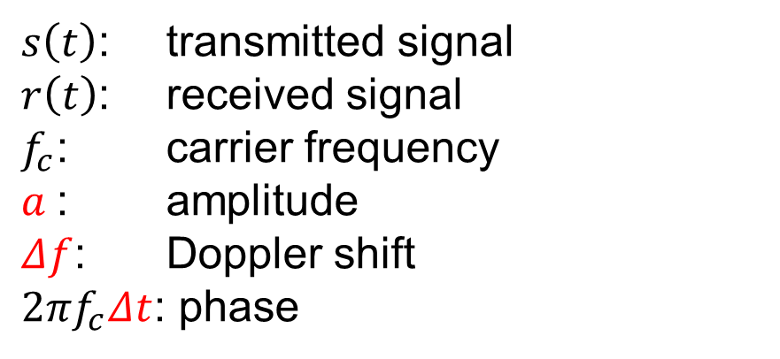


Three Degrees of Freedom
Obfuscating the 3 DoFs is sufficient!
Target
Alice
Bob

Slide 8
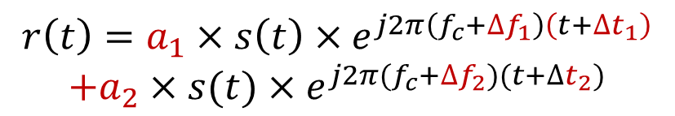
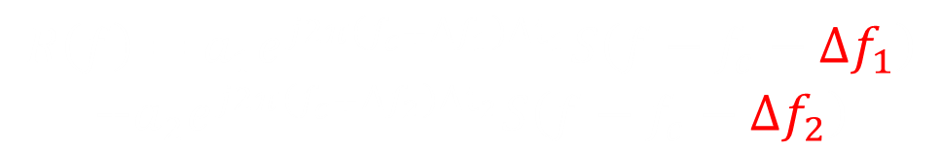
Effect of Superposition
passive reflected copy
actively reflected copy
Alice
Eve
Time domain (amplitude and phase)
  Instantaneously obfuscated
Frequency domain (Doppler shift)
  Still distinguishable after superposition
Obfuscate illegitimate sensing
Ox

Slide 9
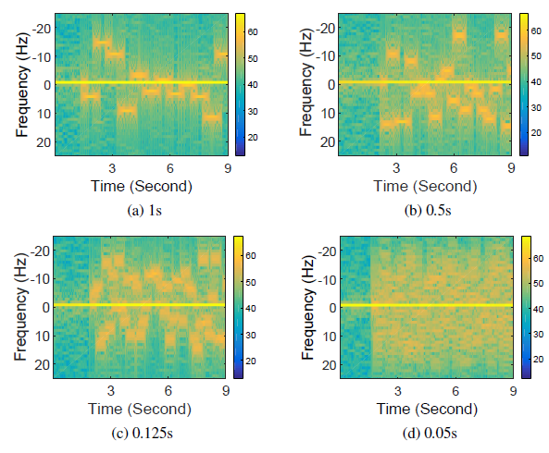
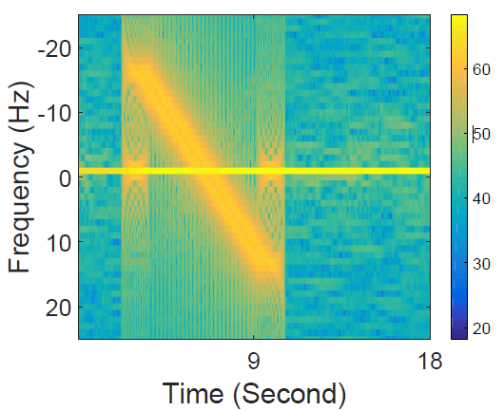
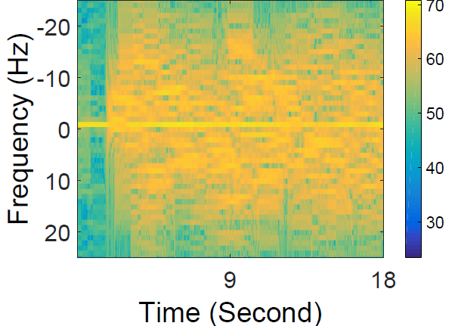
How Often to Change
PhyCloak: change the three DoF every 0.1 s
The granularity of the spectralgrams decreases as the Doppler shifts change from every 1s to every 0.05s

Slide 10

Full-duplex Operation
data
communication
Alice
Bob
Target
Obfuscation
Ox
Illegitimate
sensing
Eve
Eve: obfuscator
Full-duplex forwarding: transmit and receive simultaneously
Instantaneously forward the received copy
Bob: relay

Slide 11
Requirements
1. Obfuscate all sensor without knowing their techniques?
2. Do not degrade data links no matter what transmission protocols are being used?

Slide 12

Self-channel Estimation
Self-channel training takes air time
External data transmission
Every 100 ms!
A novel scheme:
parallel self-channel training and external data transmission
Compete for channel access via MAC?
Self-channel
H
TX RX
Alice
Ox
received
self-channel estimate
Self-interference cancellation: R - S*H
transmitted

Slide 13
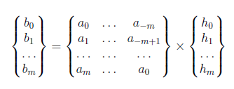
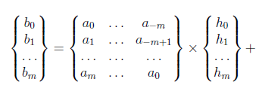
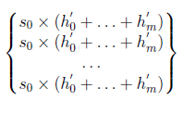
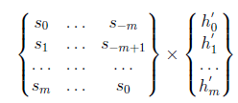
Self-channel Estimation
Training without external interference
B = A x H
H
H'
A
B
S
Ox
T R
Alice
Basic idea: Oversample to make external interference constant over several slots
Received
samples
Training sequence
Channel coefficients
Training with external interference
B = A x H +
C
S x H'

Slide 14
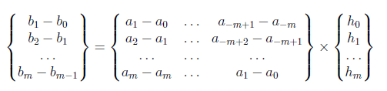
Self-channel Estimation
B = A x H +
C

Slide 15
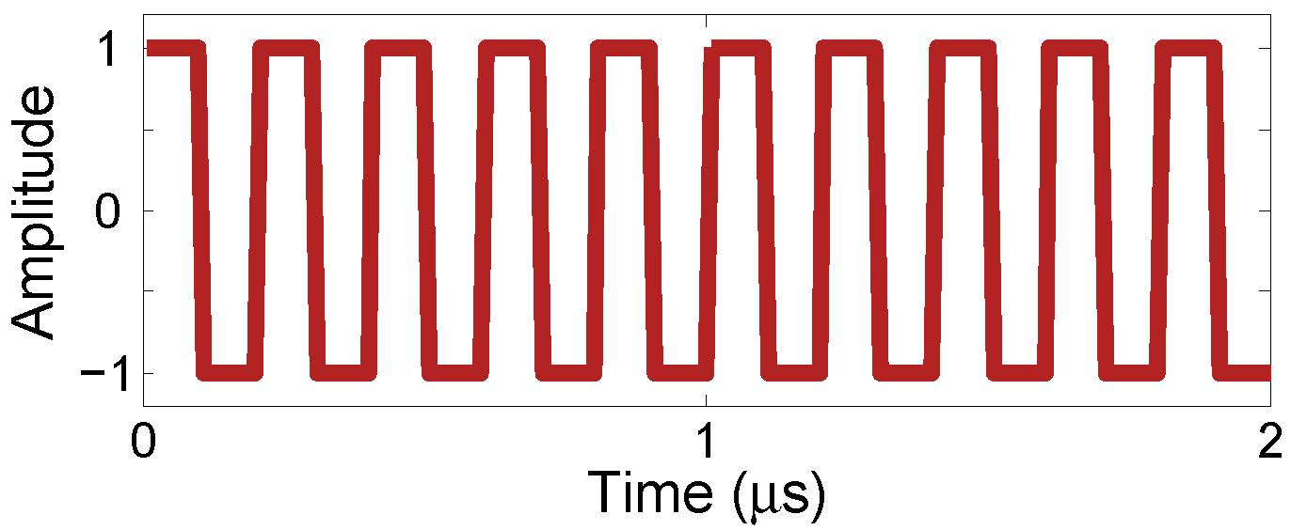
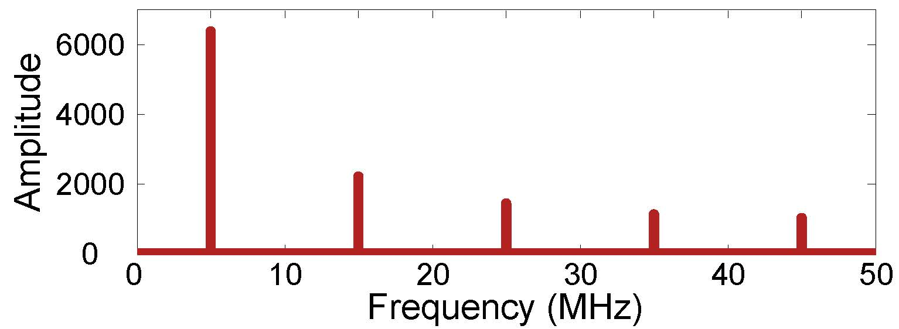
A Special Training Sequence
Unique solution
Minimum interference to external transmission

Slide 16
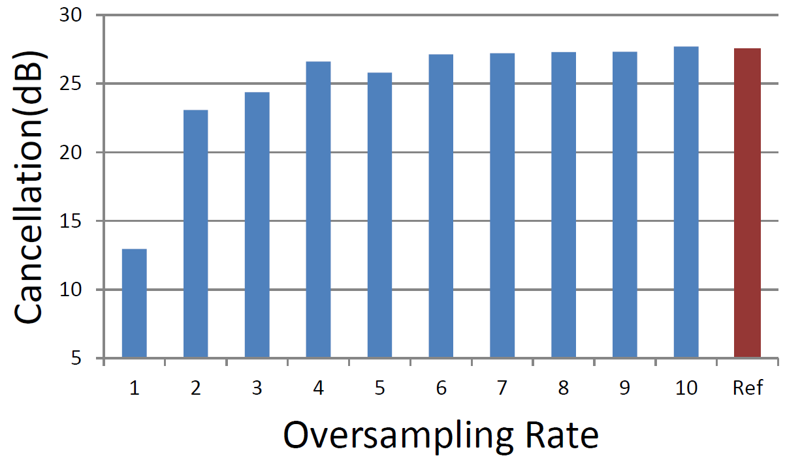

Cancellation Performance
4-time oversampling is sufficient
Ox
TX RX
Alice

Slide 17

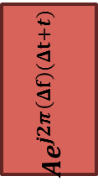
PhyCloak
data
communication
Alice
Bob
Illegitimate
sensing
Target
Eve
Ox
Conventional fullduplex design
Obfuscation
Rx
-
-
Analog cancellation
Digital
cancellation
Tx

Slide 18

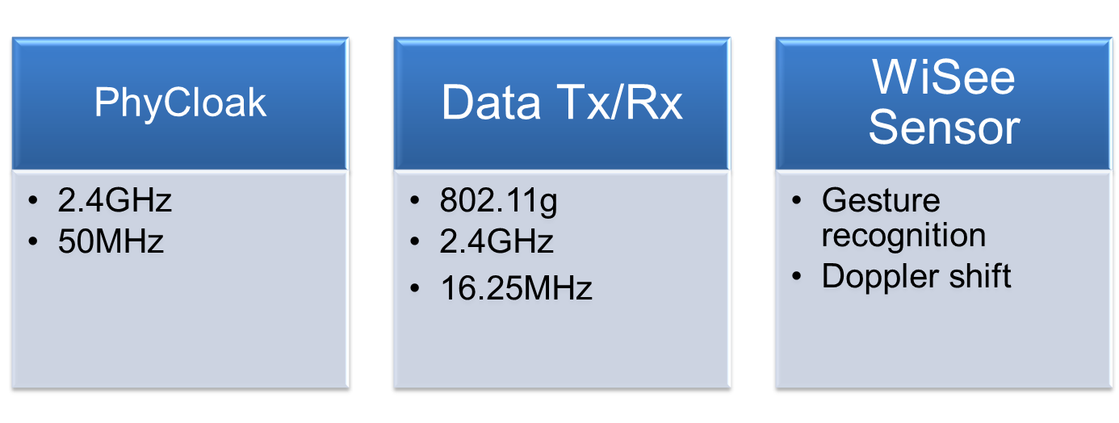
Evaluation

Slide 19
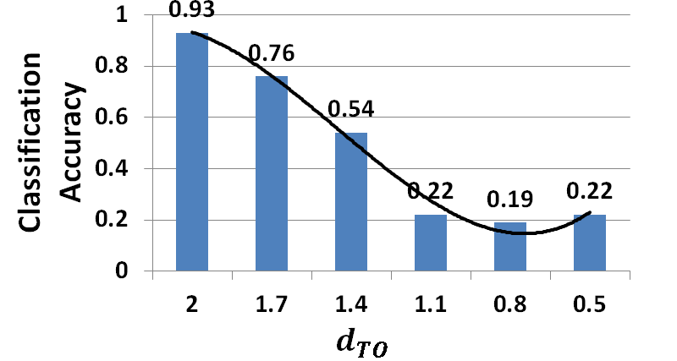



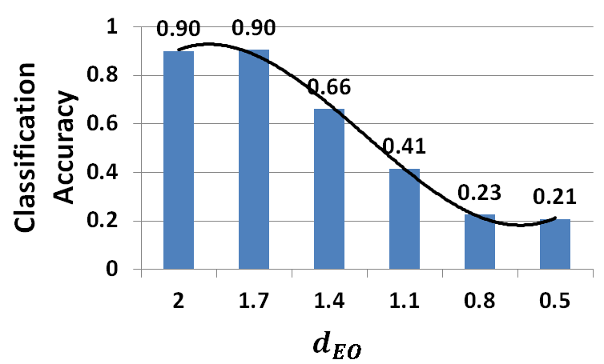

Illegitimate Sensing
Eve
1
1
Alice
Alice's location is known:
the closer to Alice, the better
0x
Eve
1
Alice's location is unknown:
the closer to Eve, the better
Alice
1
0x

Slide 20
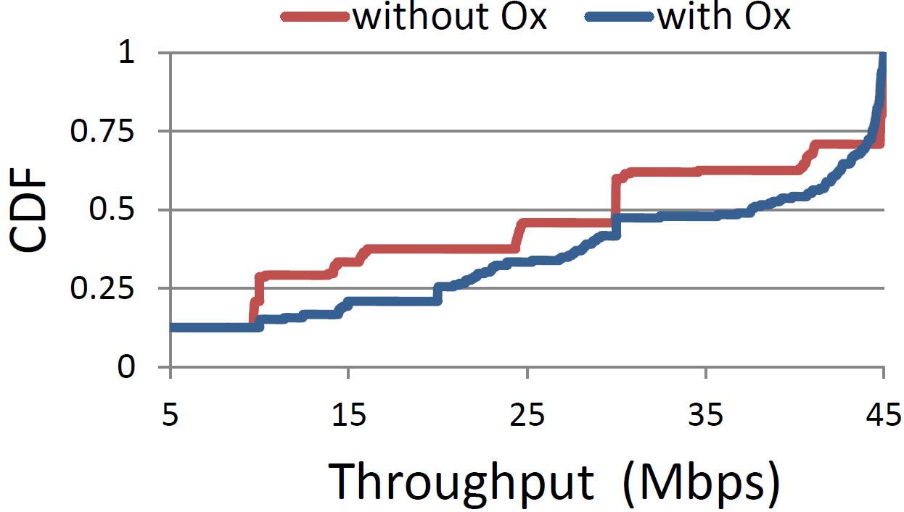
Throughput
The average throughput increases with the help of PhyCloak

Slide 21
Legitimate Sensing
data
communication
Alice
Bob
Illegitimate
sensing
Target
Eve
legitimate
sensing
||
Ox
Carol
Clean signals used for legitimate sensing
Conventional fullduplex design
Obfuscation
Sensing
Rx
-
-
Analog cancellation
Digital
cancellation
Tx

Slide 22
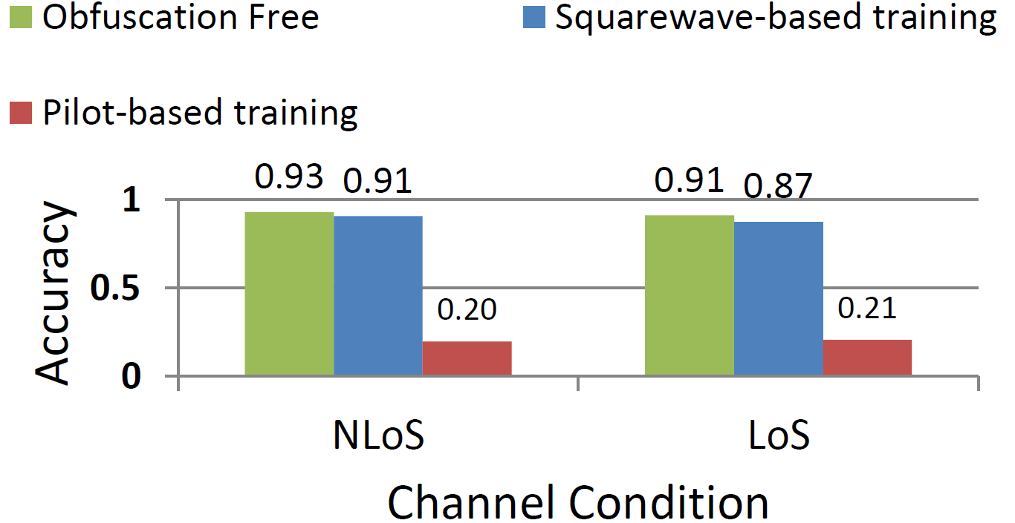
Legitimate Sensing
Squarewave based training preserves legitimate sensing

Slide 23
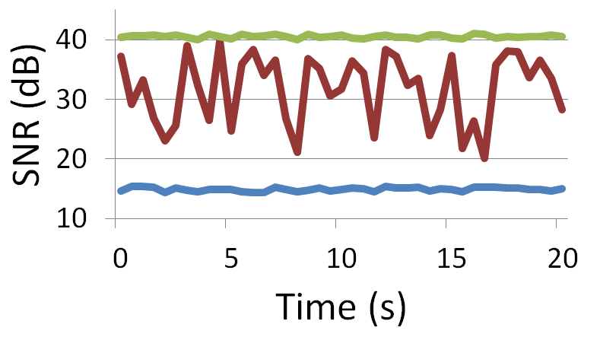

Cancellation under Varying Interference
Self-interference before cancellation
Interference caused by Alice
Residual self-interference after cancellation
External interference variation does not affect cancellation performance
Ox
TX RX
Alice

Slide 24
Conclusions and Future Work
Conclusion:
The first protection system against comm-based sensing
Obfuscate illegitimate single-antenna sensing, not degrade data throughput, and preserve legitimate sensing
Implementation on SDR platform
Future work:
Obfuscate multi-antenna sensors using multi antenna obfuscators?
Coverage provided by obfuscators?
Cooperation among multiple obfuscators?

Slide 25
Q&A
Thanks

